Slide 1
ADSAI - Y1D 2022-2023 ILO Walkthrough
Bram Heijligers

Slide 2
Table of Contents
ILO Walkthrough
Geographic Data
Medals

Slide 3
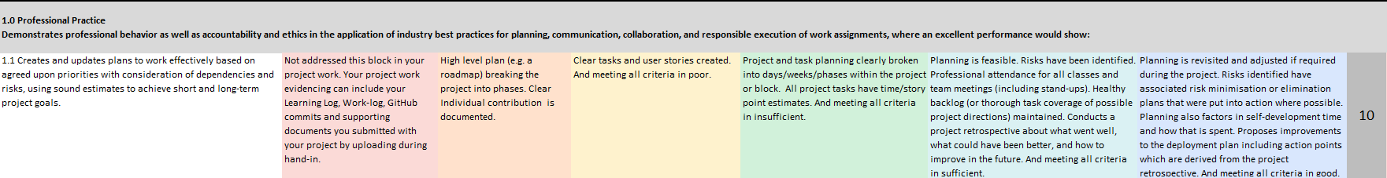
ILO 1.1
Project Planning

Slide 4
ILO 1.4
Professional behaviour; structurally improving

Slide 5
ILO 1.5
Effective communication

Slide 6
ILO 1.6
Responsibility and accountability within the team

Slide 7
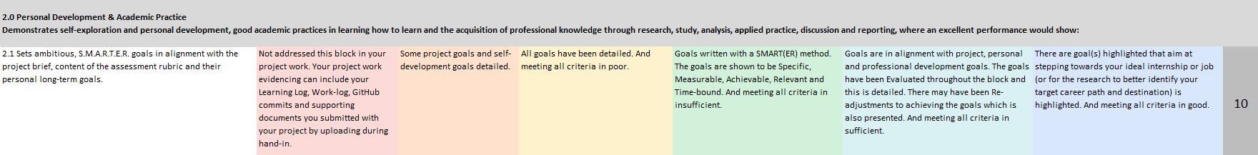
ILO 2.1
Self-directed-self-development

Slide 8
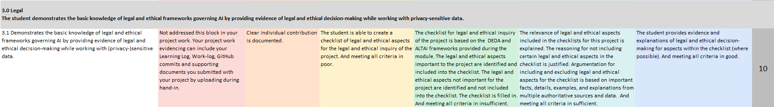
ILO 3.1
Legal & Ethics

Slide 9
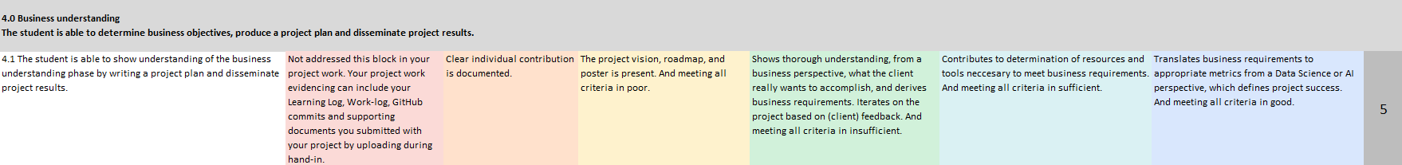
ILO 4.1
Business Understanding Components; creating and communicating about value

Slide 10
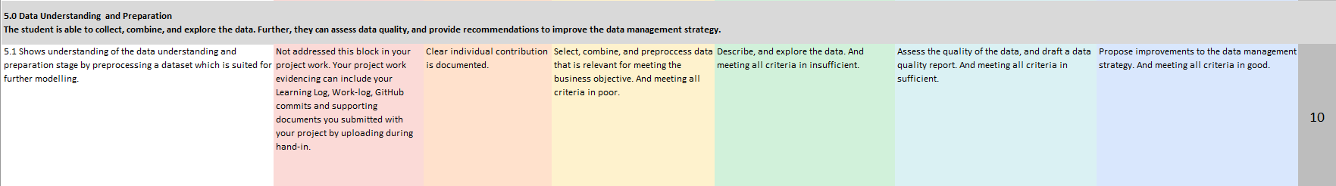
ILO 5.1
EDA

Slide 11
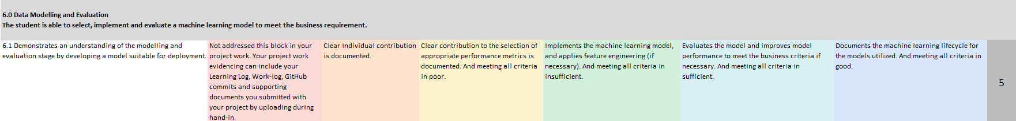
ILO 6
Modelling and evaluation

Slide 12
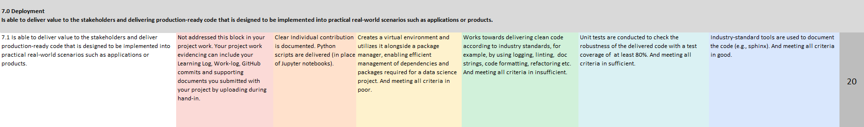
ILO 7
DEPLOYMENT!!! – Writing production ready code

Slide 13
Geographic Data
What is it? Want to work with it?
Geospatial analytics is used to add timing and location to traditional types of data and to build data visualizations. These visualizations can include maps, graphs, statistics and cartograms that show historical changes and current shifts.
e.g.
Monitor (improve)'Verbeter Breda’
Covid Dashboard
Do the optional material at the bottom of the page!
Which data?
Heat Stress Index
Move house
BOA Registrations (Still NA → NDA)
Also available:
Time-series
Sociology

Slide 14
Medals
Bronze Silver
Borislav
Borislav

Slide 15
Medals
Gold

Slide 16
Questions?

